Slide 1
Ordering positive and negative fractions and decimals
Comparing and ordering fractions and decimals (positive and negative)

Slide 2
how to use Oak lessons

Slide 3
I can order a variety of positive and negative fractions and decimals using appropriate methods of conversion and recognising when conversion to a common format is not required.

Slide 4
The absolute value of a number is its distance from zero. E.g. 5 and (-5) are both 5 away from zero and so both have an absolute value of 5.

Slide 5

Ordering positive and negative fractions and decimals
Ordering positive and negative decimals
Ordering positive and negative fractions
Order positive and negative decimals and fractions

Slide 6
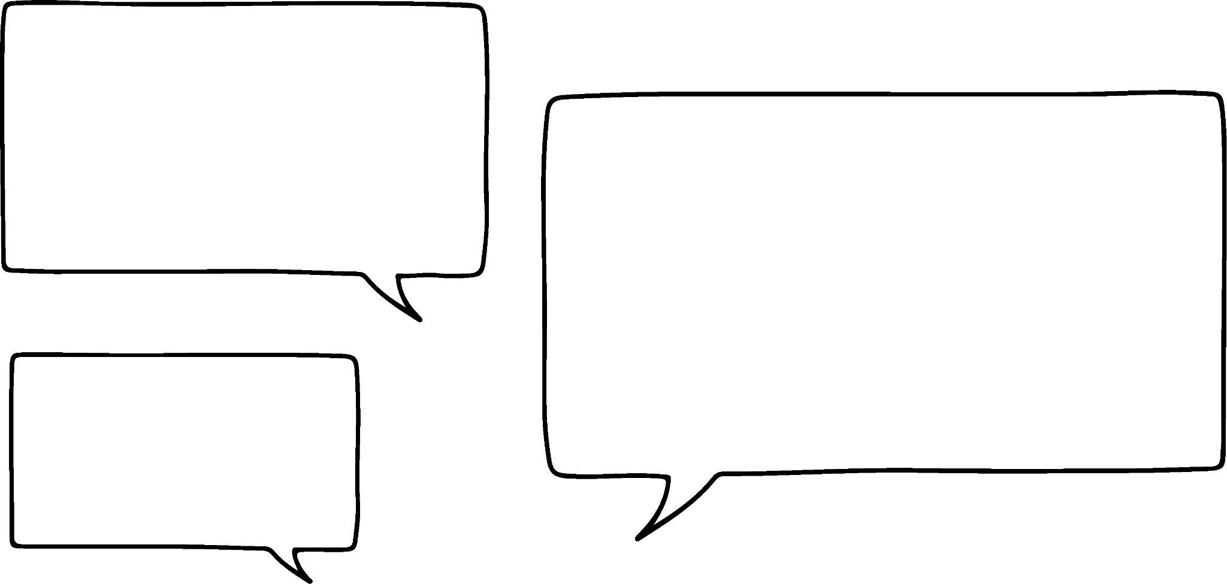

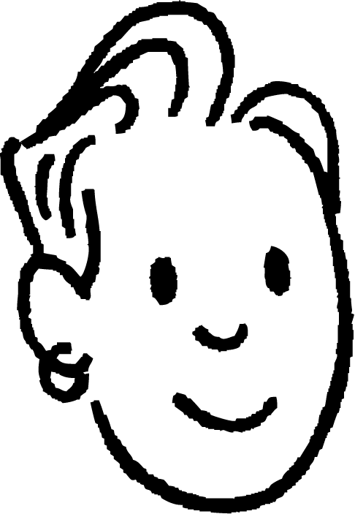
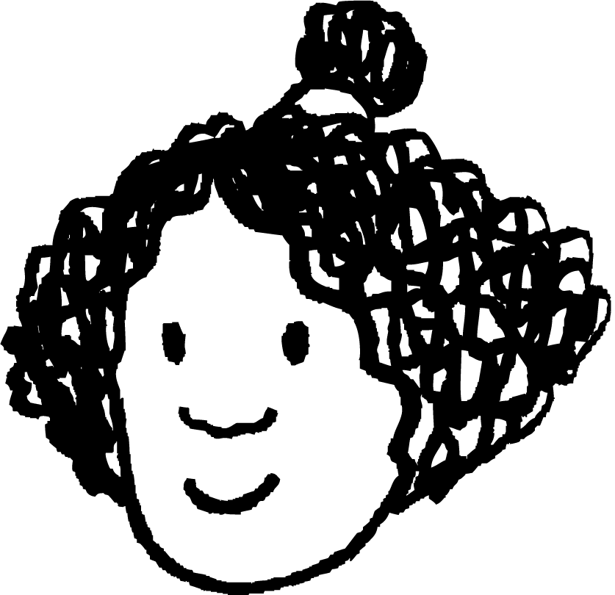

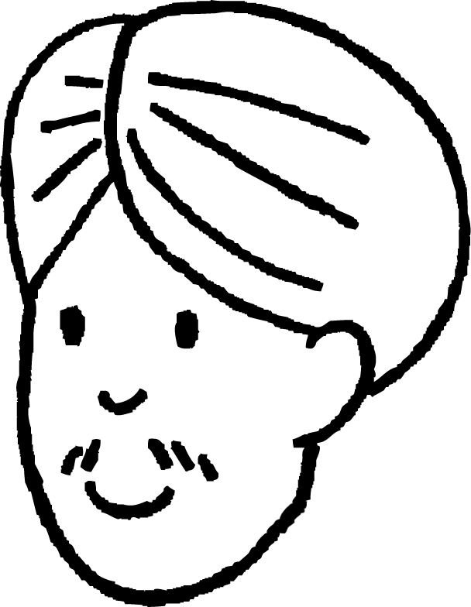
Ordering positive and negative decimals
Sam, Jun, Andeep, Izzy and Alex all have a negative balance on their canteen accounts.
My balance is (−£1.35)
My balance is (−£2.13)
My balance is (−£1.32)
Alex
Sam
My balance is (−£1.23)
Izzy
My balance is (−£2.31)
Jun
Andeep

Slide 7
Ordering positive and negative decimals
We are going to list them in order from who owes the most to who owes the least.
Here are the balances:
(−£2.13)
(−£1.23)
(−£2.31)
(−£1.32)
(−£1.35)
£2.13
£1.23
£2.31
£1.32
£1.35
Absolute values increase
Absolute values increase
0
(−£2.31)
(−£2.13)
(−£1.35)
(−£1.32)
(−£1.23)

Slide 8
Ordering positive and negative decimals
Write the following in order from smallest to largest.
(−0.57)
(−0.057)
(−0.571)
(−0.51)
(−0.517)
Will we need to do anything differently because these are not amounts of money?
No, the same applies
(−0.517)
(−0.057)
(−0.571)
(−0.51)
(−0.57)
0.517
0.057
0.571
0.51
0.57
(−0.571)
(−0.57)
(−0.517)
(−0.51)
(−0.057)

Slide 9
Ordering positive and negative decimals
Write the following in order from smallest to largest.
(−35.075)
(−35.75)
(−37.75)
(−35.57)
(−37.757)
(−37.757)
(−37.75)
(−35.75)
(−35.57)
(−35.075)

Slide 10
Ordering positive and negative decimals
Order these numbers from smallest to largest.
(−0.804)
0.804
(−0.084)
0.84
0.084
(−0.84)
(−0.804)
0.804
If I have a mixture of positive and negative numbers, I like to deal with them separately first.
(−0.084)
0.84
(−0.84)
0.084
(−0.84)
(−0.804)
(−0.084)
0.084
0.804
0.84
What do you notice?
Sam
The absolute values decrease as you get closer to zero and increase when you go past zero.

Slide 11
Ordering positive and negative decimals
Order these numbers:
(−13.02)
13.2
(−12.3)
13.02
(−12.03)
12.03
Alex has ordered the above numbers.
Has he done it correctly?
If you think he hasn’t, what is his mistake?
Here is my order.
(−12.03)
(−12.3)
(−13.02)
13.2
13.02
12.03
Alex
No, he is not right. Going towards zero he has listed from the smallest to the largest absolute value and away from zero he has listed them from the largest to smallest absolute value.
Absolute values increase
Absolute values increase
0

Slide 12
Ordering positive and negative decimals
Write the following in order from the smallest to the largest.
(−35.075), 37.05, 35.705, (−37.505), (−30.705), 35.057
(−356.9), 354.6, 305.6, (−306.5), (−35.096), 369.5
(−0.203), 2.003, 0.032, (−3.002), (−0.0023), 0.0302

Slide 13
Ordering positive and negative decimals
Write the following in order from the smallest to the largest.
(−35.075), 37.05, 35.705, (−37.505), (−30.705), 35.057
(−37.505), (−35.075), (−30.705), 35.057, 35.705, 37.05
(−356.9), 354.6, 305.6, (−306.5), (−35.096), 369.5
(−356.9), (−306.5), (−35.096), 305.6, 354.6, 369.5
(−0.203), 2.003, 0.032, (−3.002), (−0.0023), 0.0302
(−3.002), (−0.203), (−0.0023), 0.0302, 0.032, 2.003

Slide 14
Ordering positive and negative fractions and decimals
Ordering positive and negative decimals
Ordering positive and negative fractions
Order positive and negative decimals and fractions

Slide 15

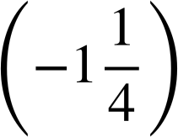

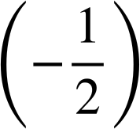
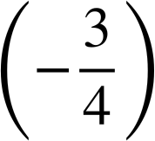

Ordering positive and negative fractions
Write these fractions in order from smallest to largest.
Is it necessary to convert these fractions to be able to order them?
We should know enough about these fractions to not have to convert them to be able to order them.
Absolute values increase
Absolute values increase
0

Slide 16
Ordering positive and negative fractions
Write these fractions in order from smallest to largest.
Absolute values increase
Absolute values increase
0

Slide 17
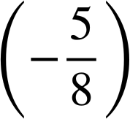
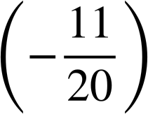
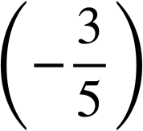
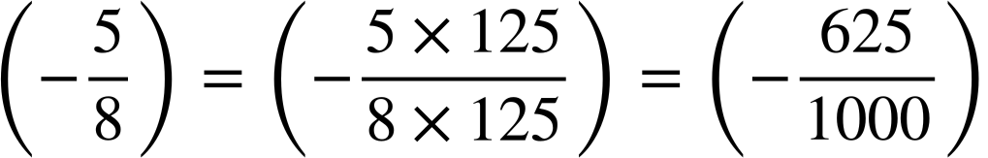
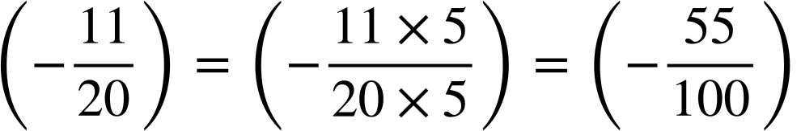
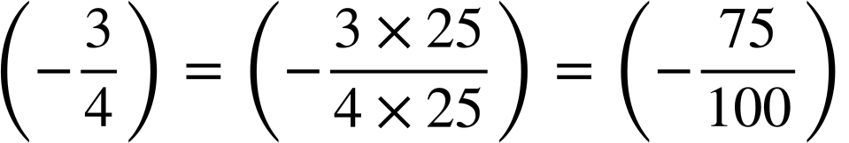
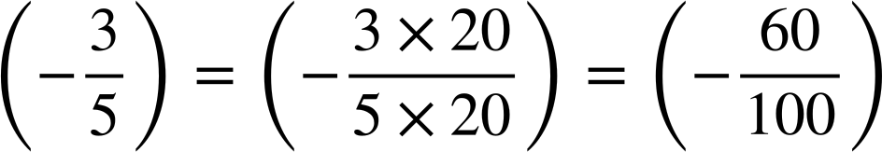
Ordering positive and negative fractions
Write these fractions in order from smallest to largest.
It is not quite so obvious with these fractions.
We can convert them all into decimals.
= (−0.625)
= (−0.55)
= (−0.75)
= (−0.6)

Slide 18
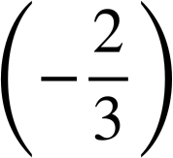
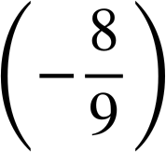
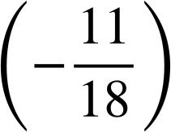
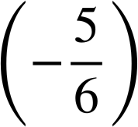
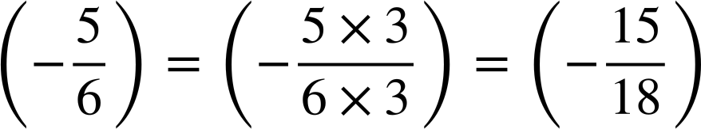
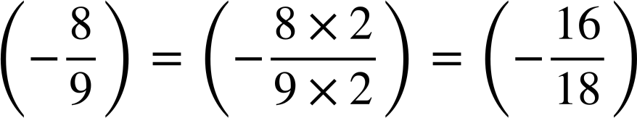
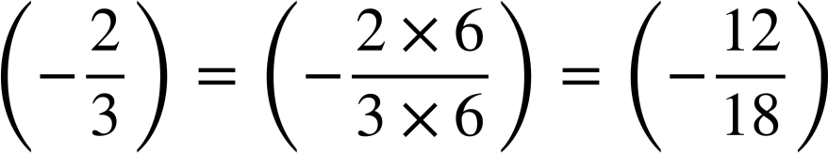
Ordering positive and negative fractions
Write these fractions in order from smallest to largest.
Will changing them into decimals be helpful here?
We would end up with some recurring decimals, so not such a good method for these fractions.
The LCM of 3, 9, 18 and 6 is 18.

Slide 19
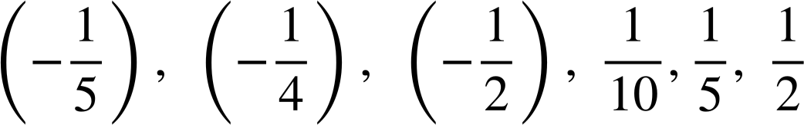

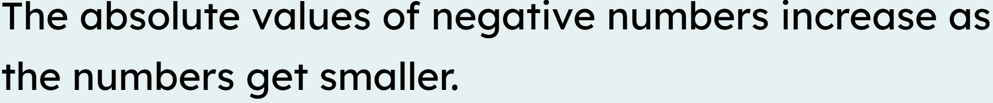
Ordering positive and negative fractions
These fractions are in the correct order, from smallest to largest.

Slide 20
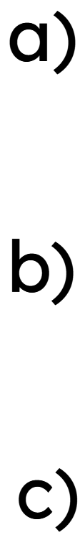
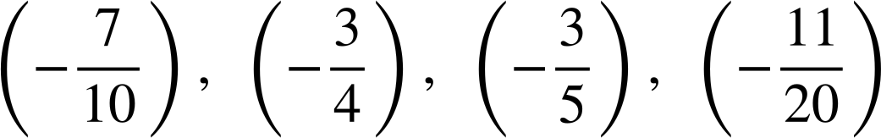
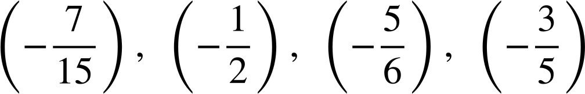
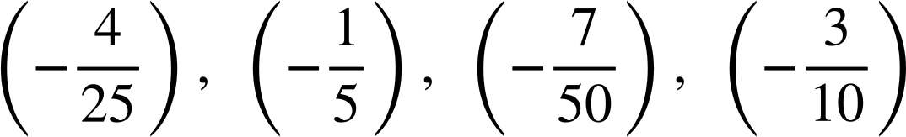
Ordering positive and negative fractions
Write the following in order from smallest to largest.

Slide 21
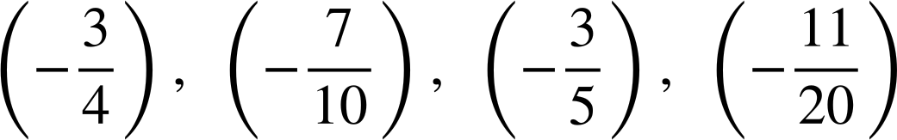
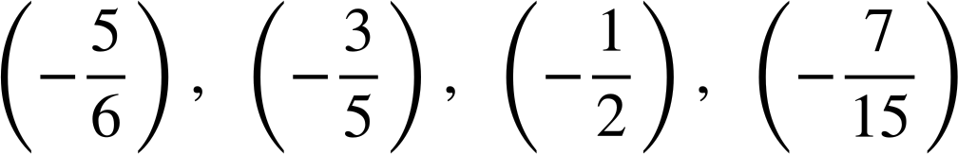
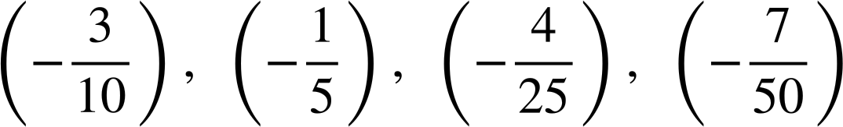
Ordering positive and negative fractions
Write the following in order from smallest to largest.
a)
b)
c)

Slide 22
Ordering positive and negative fractions and decimals
Ordering positive and negative decimals
Ordering positive and negative fractions
Order positive and negative decimals and fractions

Slide 23
Order positive and negative decimals and fractions
Now that we can order positive and negative decimals and fractions we are able to order a mixture of them.
Considering the most suitable method is useful in these situations.
Methods:
Number sense − using what we already know about the numbers
Converting to decimals - (when all denominators are factors of 10, 100 or 1000)
Converting to fractions with the same denominator
A combination of the above

Slide 24

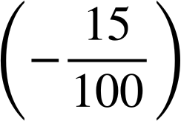
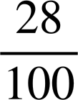
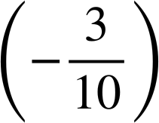
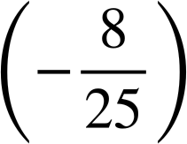

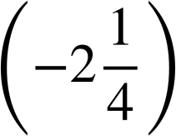
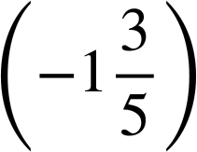
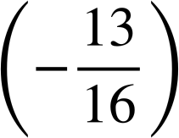

Order positive and negative decimals and fractions
Which method?
0.26
(−0.33)
Convert them all to decimals
(−1.9)
2.78
Number sense
0.375
0.25
Convert them all to fractions

Slide 25
Order positive and negative decimals and fractions
Write the following in order from smallest to largest:
(−1.9)
2.78
(−1.9)
2.78

Slide 26
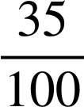
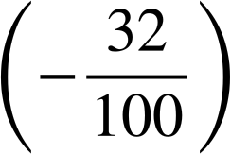
Order positive and negative decimals and fractions
Order these numbers from smallest to largest.
Convert them all to decimals
0.26
(−0.33)
0.26
0.35
(−0.15)
0.28
(−0.33)
(−0.3)
(−0.32)
Absolute values increase
Absolute values increase
0.26
(−0.33)
0

Slide 27
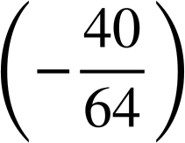
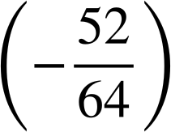
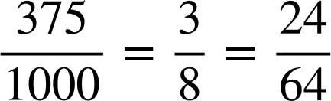

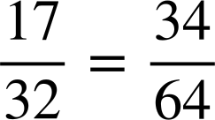
Order positive and negative decimals and fractions
Order these numbers from smallest to largest.
Convert them all to fractions with a common denominator.
0.375
0.25
Absolute values increase
Absolute values increase
0.25
0.375
0

Slide 28
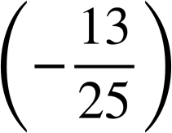
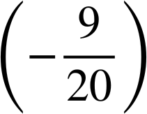
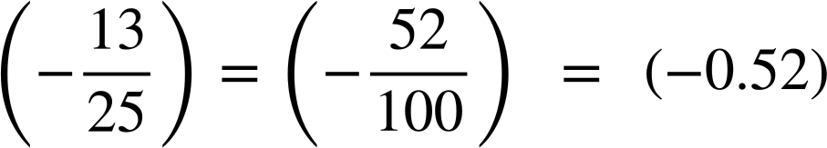
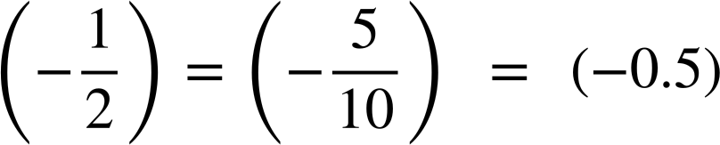
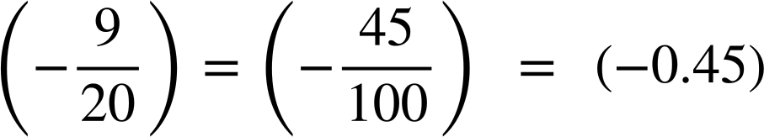
Order positive and negative decimals and fractions
Write the following in order from smallest to largest.
(−0.525)
(−0.405)
(−0.525)
(−0.405)

Slide 29
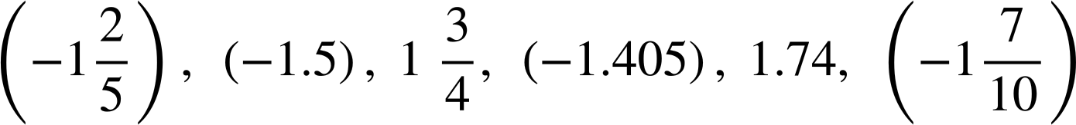
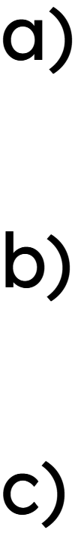


Order positive and negative decimals and fractions
Write the following in order from smallest to largest.

Slide 30




Order positive and negative decimals and fractions
Write the following in order from smallest to largest.

Slide 31

Ordering positive and negative fractions and decimals
There are three main ways of ordering fractions and decimals.
Number sense
E.g.
Converting all to decimals
E.g.
Converting all to fractions with a common denominator
E.g.

Slide 32

© Oak National Academy 2023.
Produced in partnership with Mathematics in Education and Industry.
Licensed on the Open Government Licence v3.0, except where otherwise stated. See Oak terms and conditions.

